Slide 1
Microsoft 365 ISV Benefits Program
Microsoft 365 Platform Community Call | May 25, 2022
Vesa Juvonen, Principal Product Manager
Gloria Sanchez, Partner Marketing Manager

Slide 2
Agenda
Microsoft Viva Connections and the Viva Ecosystem
What is the Microsoft 365 ISV Benefits Program & Goals
Go-To-Market Benefit Highlights
How to Enroll

Slide 3



Hybrid work | A durable trend
73%
of employees want flexible remote work options to stay
80%
of leaders say they plan to make major changes to their flexible work policies
67%
of employees want more in-person work or collaboration post-pandemic
Microsoft Work Trend Index: 2021 Annual Report
Notes:
It’s clear that there’s no going back to our pre-pandemic reality. ​
​
Data from our latest Work Trend Index report shows that: ​
73 percent of employees are saying they want flexible remote work options to stay, and more than 80 percent of leaders say they expect to make major changes to accommodate. ​
At the same time, 67% of employees want more in-person work collaboration. ​
​
In this next post-pandemic chapter, we have an opportunity to bring the best of both worlds together in a way that creates a great employee experience, but it is going to take a whole organizational shift spanning physical environment and office spaces, culture and talent as well as technology.​
​

Slide 4

Challenges
People feel disconnected Nearly 60% of people say they feel less connected to their team after shifting to remote work.¹
Burnout is a global problem
85% say wellbeing has declined and 56% say job demands have increased.²
People spend about an hour per day searching for or recreating information
Using multiple tools drives context switching, drains productivity and creates frustration.³
CEOs are concerned about talent and skills
79% of CEOs worldwide are concerned that a lack of essential skills in their workforce is a barrier to future growth.⁴
Too many apps disrupting workflows
The average organization now has over 200 work-related apps their employees need to use to get work done.
¹Microsoft Work Trend Index: 2020 Annual Report
²Jennifer Moss, Beyond Burned Out, Harvard Business Review, February 10, 2021
³Spiceworks/Ziff Davis survey commissioned by Microsoft, 2021
⁴PwC CEO Survey, 2019
Notes:
The accelerated shift to remote and hybrid work has taken its toll on people around the globe. Data shows us that problems of disconnection, burn out, time management, and talent development may be getting worse. ​
​
How have you seen these issues impacting your workforce?​
​
We know that a sense of belonging is important to have at work. Employees who feel like they belong are happier and stay at their jobs longer. However, nearly 60% of people say they feel less connected to their team since the shift to remote work (Work Trend Index), which leads us to a common question that’s been asked during the pandemic: how can we create the connectedness we feel from in-person work while working remotely?​
​
Over the last year, many of us have seen how easy it is for the line between work and life to blur. We are always on, making sense of incredible amounts of information while multiple tasks and deliverables demand our attention at any given time. According to a recently published global survey, 85% say their wellbeing has declined and 56% say their job demands have increased. This always-on mode is unsustainable.​
​
Our research shows that people spend about an hour a day – or up to seven weeks a year – searching for or recreating information.​
​
Employees today often have several tasks they are working on simultaneously. But frequent context-switching – for example: switching between emails, chats, and Word documents while searching for various content on computer – prevents people from getting on a roll with their work. The question is: how do we get you the content and information you need without constant interruptions?​
​
Our intent is to help solve key pain points in the learning space, and we know there are a lot of them. 79% of CEO’s say talent and skills of their workforce is their number one issue, meanwhile employees spend only 1% of their workweek on formal learning. Based on these we can see the skills gap is real and we know the time gap at work is also real.

Slide 5




The driving force for any business is its people.
Employee Engagement
86% of top-performing companies reported that digital training programs boosted employee engagement and performance.¹
Employee Satisfaction
94% of employees say they would stay at a company longer if it invested in their learning and development.²
Employee Retention
Highly engaged employees are 12x less likely to leave their company than those who are not engaged.³
Profitability
Organizations with highly engaged employees have 21% greater profitability.⁴
¹PwC’s Global Digital IQ survey, ²LinkedIn Learning 2020 Workplace Learning Report, ³Glint, ⁴Gallup
Notes:
One thing we do know is that, more than ever, people are the key to business success. These stats and plenty of other research shows when we invest in our people, and we focus on the employee experience, we can directly impact employee engagement, retention, satisfaction and a company’s financial success.​
​
But in this current environment, where people are physically apart, more stressed and lacking connection, it can be harder than ever to create a great employee experience.​ ​

Slide 6

What is an Employee Experience Platform (EXP)? A digital platform that helps organizations create a thriving culture with engaged employees and inspiring leaders
Purpose and Alignment
Mission, Goals, and Outcomes
Achievements and Recognition
Growth and Development
Learning and Coaching
Onboarding, Lifecycle Moments
Talent Mobility
Culture and Communications
News, Events,
Company Resources
Communities
Employee
Wellbeing and Engagement
Physical, Mental, Financial
Nudges, Feedback, and Sentiment
Knowledge and Expertise
People and Experts
Documents and Content
Notes:
Technologies like Microsoft Teams have helped us all adapt to hybrid work, but there's so much more we can do to create a great employee experience.
Today, there are a lot of vendors focused on employee engagement and wellbeing. But they are mostly point solutions looking to solve one or a few of the symptoms in separate experiences.
They are fragmented. What is needed is a new approach and a new category of technology solutions.
Our vision is an integrated employee experience that brings together all these resources into the natural flow of everyday work. We call Employee Experience platforms or EXP.

Slide 7



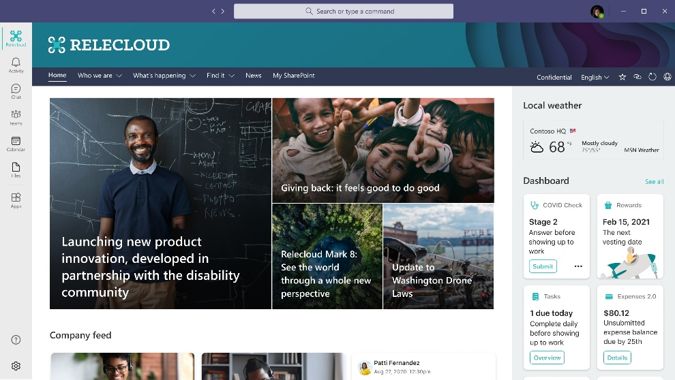
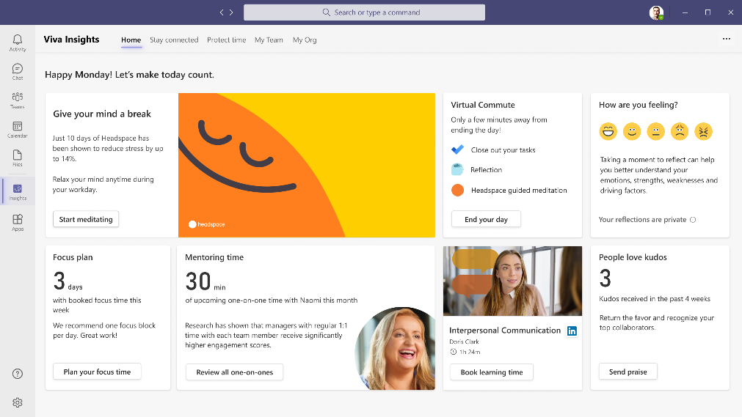
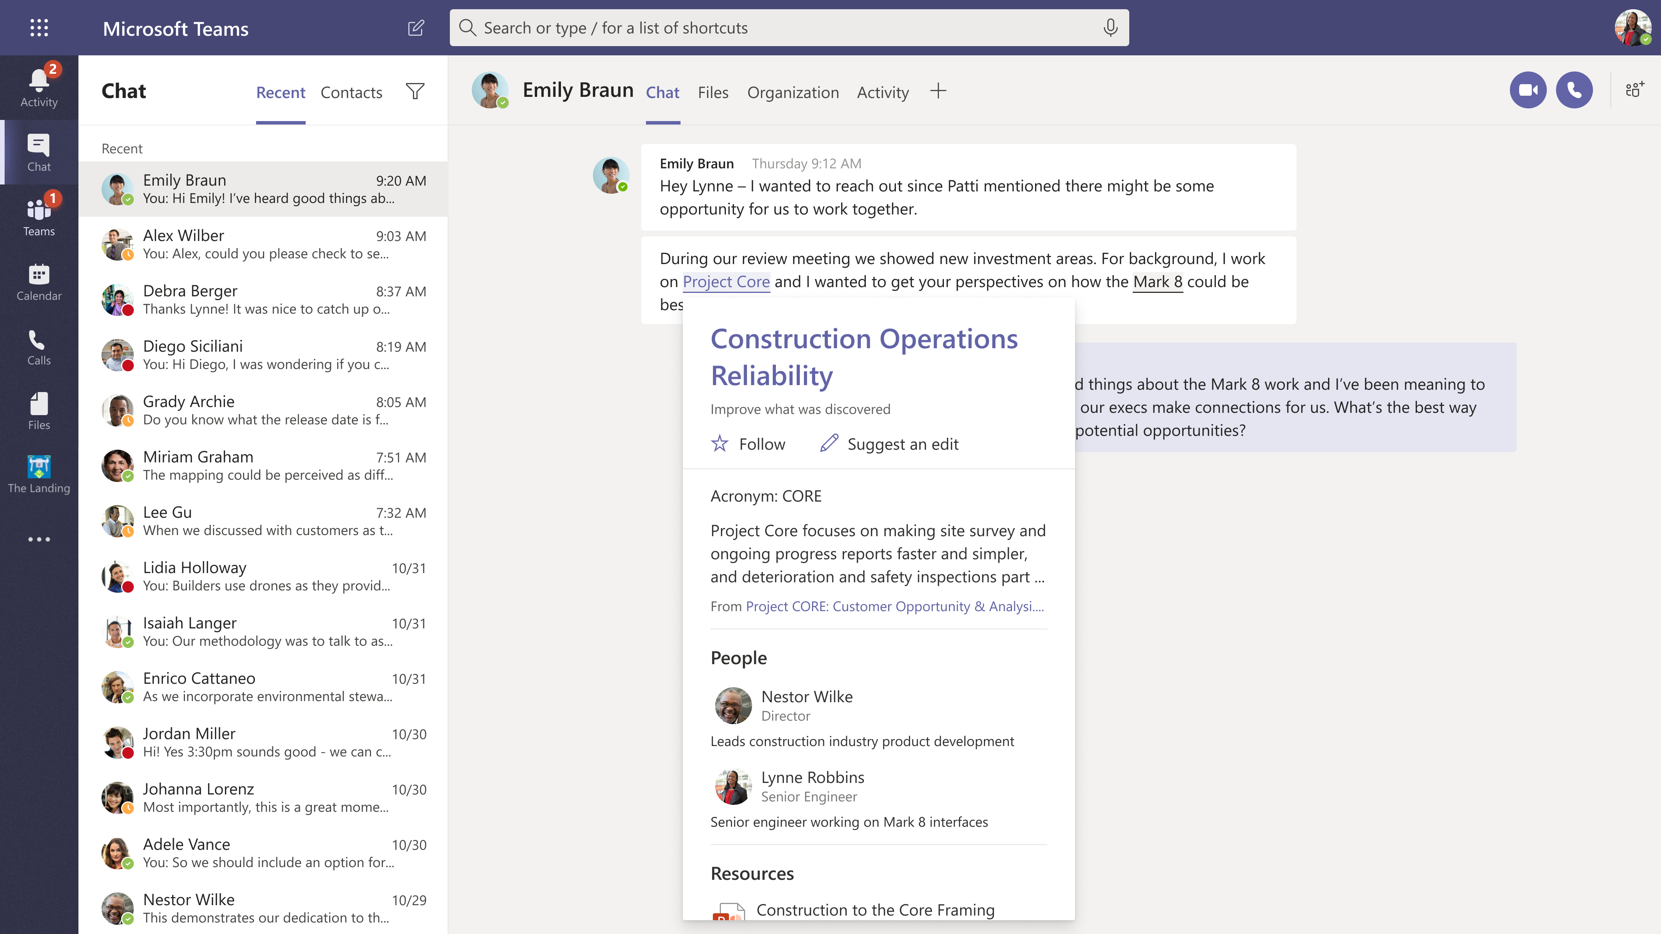
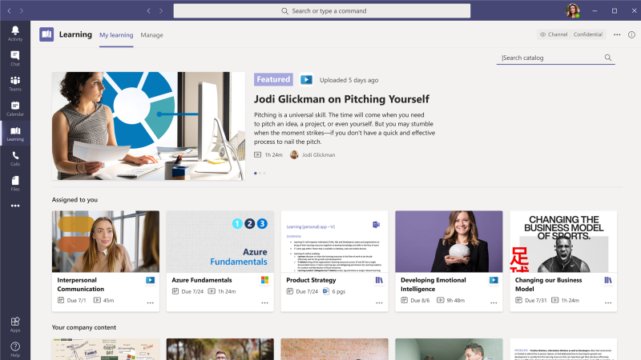
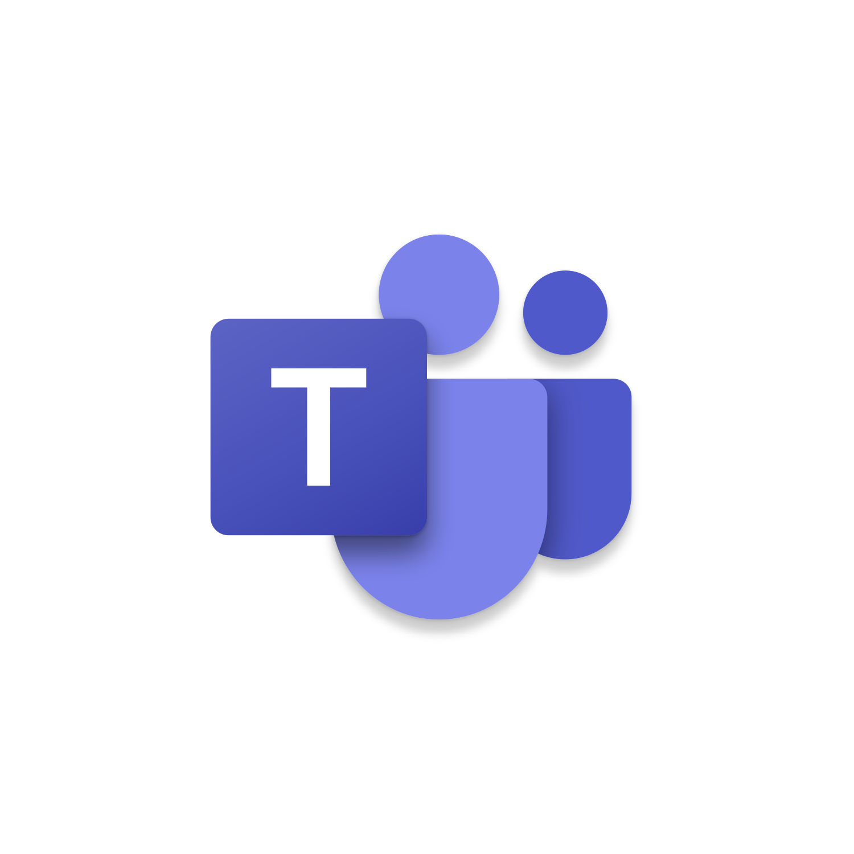
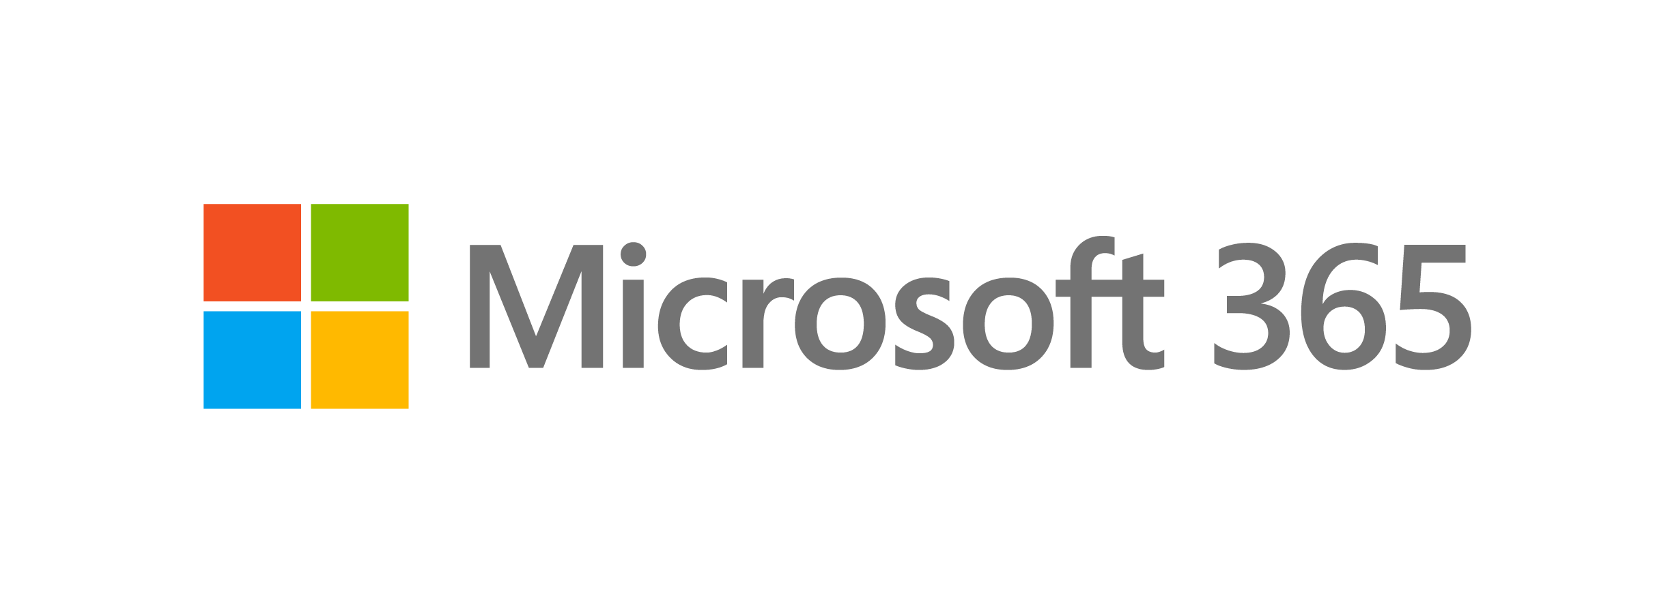
- Microsoft Viva -
Employee Experience Platform for the Digital Era
Viva Connections
Viva Insights
Viva Topics
Viva Learning
Viva Platform and Ecosystem
ERP
HCM
LMS
Content
Apps
CRM
Wellness
Many more…
Notes:
In addition, Viva provides an open and extensible platform, with an ecosystem of partners so it works with many of your existing systems and tools. ​Therefore you don’t have to do rip or replace what you have. Instead, you can extent your existing investments by better connecting them together and by making them available in a more modern experience to your employees.​
​
So we are taking a Platform and Ecosystem approach with Viva.​
​
Now let’s dive into each of the Viva modules in more detail.

Slide 8
Dev Toolkit and/or API Availability Timeline
November 2021
Viva Connections
H2 CY2022
Viva Topics & Viva Learning
TBD
Viva Insights

Slide 9
M365 ISV Benefits Program
We support Microsoft Teams and Viva ISV partners to build, promote, and achieve greater scale with their Microsoft Viva apps.
https://aka.ms/modernworkisv
Microsoft technology
1:1 Technical consults
Marketing Support
Notes:
We are very pleased to share that we are introducing a new set of benefits to help Viva ISVs bring their best collaboration experiences These benefits will allow you to build, and promote their apps

Slide 10
Benefits for Viva and Teams ISVs building for M365
Product benefits and skilling vouchers
1:1 sessions
Get ready to publish in AppSource and unlock GTM awareness
Activate demand generation & customer awareness benefits *
Get your app noticed by field teams globally *
M365 E5 dev subscription
Azure credits
Envision, design, and build
Press release and social media
Co-sell ready launch assets
LinkedIn ad credits
Webinars
Field driven campaigns
Customer roundtables
. Visit aka.ms/ModernWorkISV to learn how to qualify and additional details
Notes:
Partners can get over 20 benefits to help them accelerate their Viva development and GTM
These benefits include access to Microsoft technology, like Microsoft Azure credits, 1:1 consults with Microsoft experts to help you design and build your app and take advantage of all the great features built in the Microsoft 365 platform
Certification vouchers that your team can leverage for skilling
We will provide you with marketing resources to increase your exposure to new customers and support to increase your visibility with our Microsoft field.

Slide 11
Marketing activities overview
App | Microsoft Viva Connections Apps | Milestones
 | Viva Connections Apps | Viva Connections Published (Starter Tier) | Viva Connections Published (Enhanced Tier)
1 | Commercial Marketplace and/or SharePoint store listing optimization | ✓ | ✓
 | Commercial Marketplace marketing toolkit | ✓ | ✓
 | Commercial Marketplace forums | ✓ | ✓
 | Commercial Marketplace What's New blog | ✓ | ✓
 | Co-sell solution finder listing guidance | - | -
 | Digital marketing content on-demand | ✓ | ✓
 | Launch asset development support | ✓ | ✓
2 | Promote app to Microsoft field |  | ✓
 | Press release or blog with social amplification |  | ✓
 | Joint external webinar |  | ✓
 | Customer success story development |  | ✓
 | Customer roundtable session* |  | ✓
 | Inclusion in Microsoft-run campaign* |  | ✓
3 | Featured placement on SharePoint store |  | ✓
 | Featured in SharePoint store |  | ✓
4 | Microsoft seller webinar |  | ✓
 | Microsoft executive blog or event endorsement |  | ✓
* Limited availability, based on campaign alignment ** Additional criteria, see program guide and marketing activity details

Slide 12
How to Enroll
Visit our “Get Started” section on aka.ms/modernworkISV page to review and complete requirements:
Become a member of the Microsoft Partner Network and get an MPN ID, if you have not yet joined.
Agree to terms and conditions in the Microsoft 365 ISV Program Benefits Agreement and Microsoft 365 ISV Benefits Program Guide.
Complete the Microsoft 365 ISV Benefits Submission Form.
Questions? Please contact the Microsoft 365 ISV Benefits Service Desk.

